Slide 1

USWDS Monthly Call
June 2021
1
Notes:
Slide 1. Hi there and welcome to the U.S. Web Design System monthly call for June 2021. It’s a busy month and a busy month for the changing color of the USWDS logo. Earlier this month [CLICK] we saw a partial solar eclipse on the east coast (and the logo changes to black and orange). At the end of the week [CLICK] it’ll be Juneteenth (and the logo changes to the Juneteenth colors of red, white, and blue), next week, it’s [CLICK] the summer Solstice (and the logo changes to summery golds), and all month, of course [CLICK] is pride (and the logo changes to the colors of the rainbow: red, orange, yellow, green, and blue).

Slide 2

Hi!
Thanks for being here!
2
Notes:
Slide 2. My name is Dan Williams, and I'm the USWDS product lead and this is my avatar, which may or may not look like me. Either way, thanks for being here! First, I'd like to mention that we're recording this monthly call, so please refrain from turning on your camera. We will manually turn off any cameras to ensure the recording doesn't show us on camera. I’d also like to remind you that all attendees must abide by the TTS Code of Conduct, which is online at handbook.tts.gsa.gov/code-of-conduct. We’ve posted the link to the code of conduct in the chat. We'll be posting other links and references into the chat as we go along, and I encourage you to ask questions in the chat at any time. If any member of our team can answer your question in the chat, we'll do so, otherwise there'll be some time for questions and answers at the end of the hour. Also, be sure to introduce yourself in the chat as well — it's nice to know who's here. It's good to have you here today. For those of you who find the chat distracting, you’re welcome to close or hide the chat window during the main presentation. You can reopen it later during the Q&A session at the end of this call. So thanks! And, with that, let's get started!

Slide 3
A quick poll
Do you currently help maintain a site with multilingual content?
Yes
No
3
Notes:
Slide 3. So, to kick things off, a quick lil poll: Do you currently help maintain a site with multilingual content? 1: Yes. 2: No. If you're interested in answering, give it a go. We're just interested to hear more from folks on the call. If you can't see the poll or can't access it for any reason, either put your answer in the chat, or just feel comforted that it's a pretty unserious poll with no stakes. We'll share out the results in just a minute. I know that from the USWDS perspective, we're starting to do more to support content that is not in English, starting with Spanish-language versions of some of our components. But we still have a ways to go to build design system components and layouts that support downstream multilingual implementations and more comprehensive documentation of multilingual content elements on our site.

Slide 4
Agenda
Site launches Introducing Pagination Product updates Q&A
4
Notes:
Slide 4. So what's our agenda for today? [CLICK] First, as always, we'll show off a few nice new site launches. [CLICK] Then we’ll get an introduction to a brand new design system component: pagination. [CLICK] And then I’ll follow up with a few more product updates to round out the presentation. [CLICK] And as we’ve been trying to do lately, we’ll do our best to keep the presentation on the short side so we have some more time to get questions and feedback from you — so ask questions in the chat as we go, or hold on to your Qs to the end. And let’s get started.

Slide 5
Site launches
Notes:
Slide 5. Let's get into site launches.

Slide 6
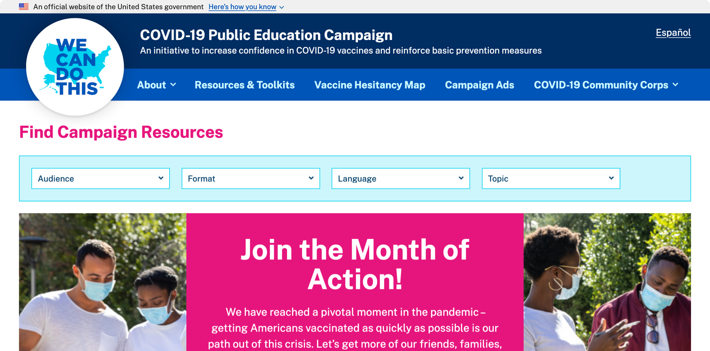
COVID-19 Public Education Campaign
wecandothis.hhs.gov
Notes:
Slide 6. First up, wecandothis.hhs.gov, the website of the COVID-19 Public Education Campaign — it’s a really slick implementation created to increase confidence in COVID-19 vaccines and reinforce basic prevention measures. As we see from the homepage here, the bulk of the site is centered around finding downloadable resources and videos. We’ll be able to help if they ever want to update their pagination component!

Slide 7
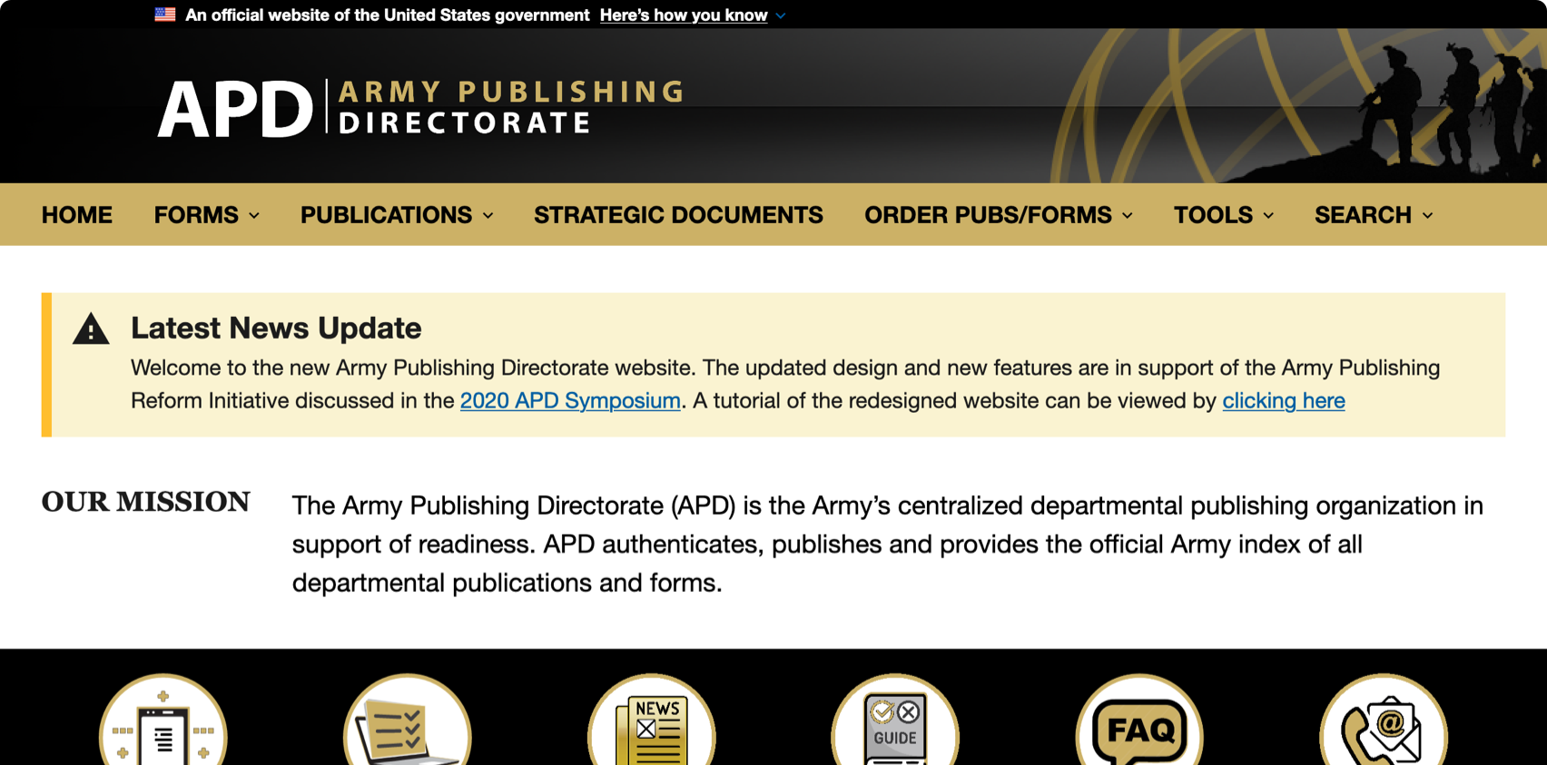
Army Publishing Directorate
armypubs.army.mil
Notes:
Slide 7. Next, armypubs.army.mil, the site of the Army Publishing Directorate. APD is the Army’s centralized departmental publishing organization in support of readiness. It authenticates, publishes and provides the official Army index of all departmental publications and forms. As with any site focused on finding, filtering, and sorting information, they might be able to see some benefit from using paginated content and our Pagination component.

Slide 8
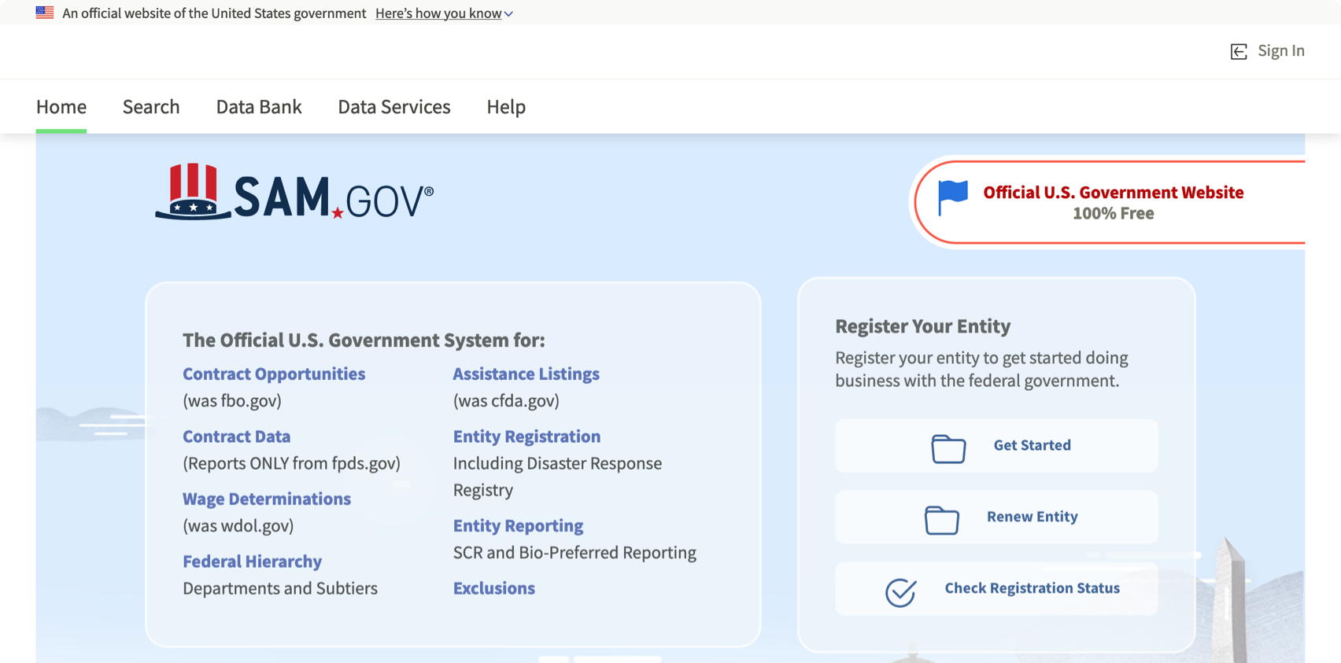
System for Award Management
sam.gov
Notes:
Slide 8. Next, it’s sam.gov, the system for award management. Both current and potential government vendors are required to register in SAM in order to be awarded contracts by the Government , so this is a pretty important system. Congratulations to the SAM team for finishing a complex beta program and integrating all their new work into the new sam.gov.

Slide 9
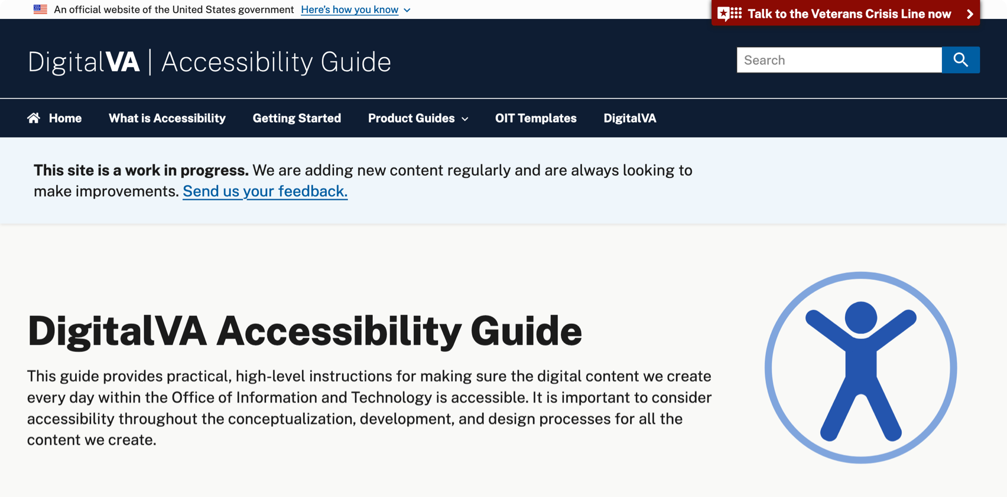
DigitalVA Accessibility Guide
www.oit.va.gov/accessibility
Notes:
Slide 9. Next, www.oit.va.gov/accessibility, the DigitalVA Accessibility Guide. If you’re interested in building accessibility into what you deliver in Word, Powerpoint, Excel, or Email (and you should be!) this is a really useful resource. In fact, I used it when making this very slide deck! And while we don’t see it here at the top of this home page — where we do see a strong blue header and navigation, and an introduction to accessibility resources — this site has a particularly nice use of the USWDS Identifier, collecting required links at the bottom of every page.

Slide 10
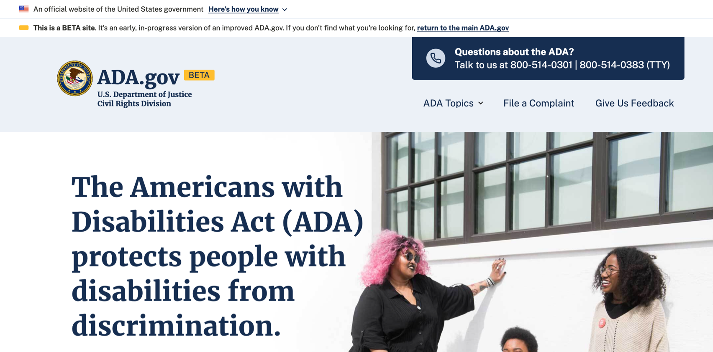
Americans with Disabilities Act (beta site)
beta.ada.gov
Notes:
Slide 10. And finally, beta.ada.gov, a new beta site from the Americans with Disabilities Act team at the United States Department of Justice Civil Rights Division. Their new site takes design cues from the good work they did with their civil rights complaint portal, and makes some very needed updates. You can get a good idea of degree of change here by opening beta.ada.gov alongside the original ada.gov.

Slide 11
Great work!
Notes:
Slide 11. Great work, everyone! Be sure to let us know when a new site launches, either with an email to uswds@support.digitalgov.gov or a note on the USWDS public Slack channel.

Slide 12

An Introduction to Pagination
Navigation for paginated content
Notes:
Slide 12. Now we’re going to take a look at the newest component in the design system with an introduction to Pagination: navigation for paginated content. Pagination is a curious little component — one that started out seeming like a small project — just a few buttons with page numbers in a row, with previous and next buttons — like we see on the slide here — helping users move between numbered pages. And it is simple in its way, but within pagination is a lot of behavioral complexity. So today we’ll hear from the USWDS Core team about how we built this component, and take a look at the component in action.

Slide 13
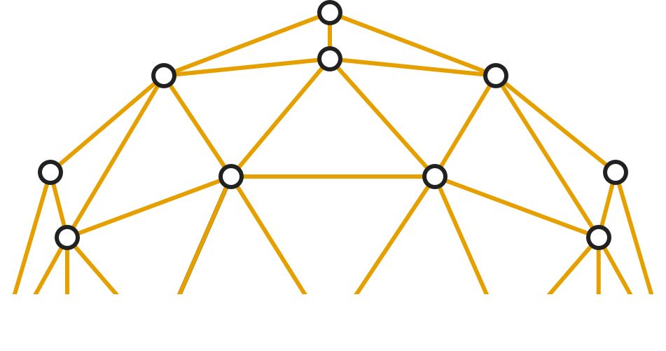
Sofya Savkina James Mejia Katie Kline
USWDS Core Team
Contractors
Notes:
Slide 13. So to introduce us to Pagination, I’d like to welcome three members of the USWDS Core team, Sofya [SOAF-ya] Savkina [SAV-kih-nah], James Mejia, and Katie Kline. We’ll start with UX and usability research with Sofya. Sofya, take it away…

Slide 14
Component design phases
Exploration
Validation
Iteration
Notes:
Slide 14. Thank you, Dan. Hello everyone, my name is Sofya, and I’m a user experience researcher on the USWDS team. There are several steps that go into creating a new design system component, and it was exciting to work through those steps with the team! We started by breaking down our UX research and design process into three phases: Exploration, Validation, and Iteration. I will take you through each of these phases in detail.

Slide 15
Exploration
What we did: Landscape analysis to determine conventions and best practices
Outcome: Prototypes for both the component design and guidance for testing and validation
Notes:
Slide 15. Exploration phase We started with landscape analysis, reviewing UX and design best practices for pagination, and how other design systems and websites solve for presenting paginated content to users. We took what we learned and put our best assumptions into a prototype.

Slide 16
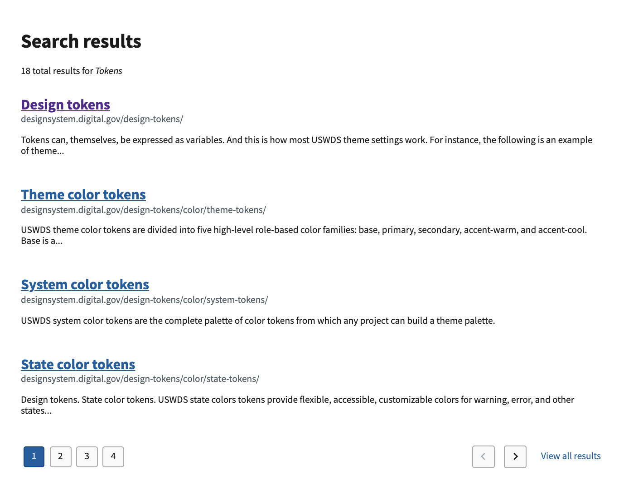
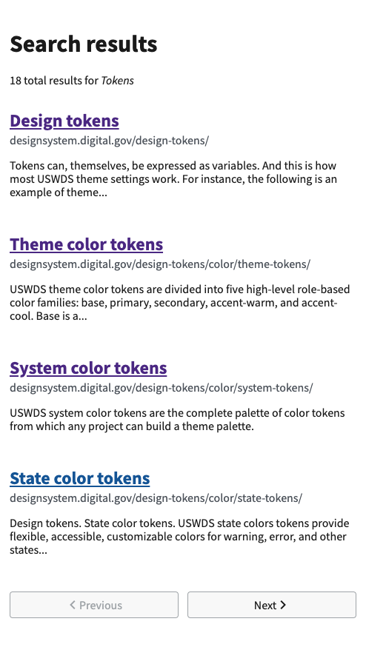
Pagination Design (first draft in context)
Notes:
Slide 16. This is the prototype we created to test with users. It’s a standard search results page with 5 different results with descriptions underneath. At the bottom left hand corner there are 4 square buttons with numbers 1234, the first button is highlighted in blue and the rest are white. On the bottom right there are two buttons with arrows indicating previous and next, and a clickable link with the text “view all results”. The desktop orientation is displayed on the left, and the mobile layout on the right. In the mobile layout, the page looks more narrow and the pagination component at the bottom is simplified to the 2 buttons: previous and next.

Slide 17
Validation
What we did: Slack community outreach, usability testing, stakeholder interviews
Outcomes: Focused research questions, rich usability insights, additional government use cases
Notes:
Slide 17: Validation phase This is where we took our assumptions and put them through several rounds of validations. We started by asking our Slack community of USWDS practitioners for feedback. This feedback helped us validate initial assumptions with experts and also helped uncover knowledge gaps. As a result, we were able to focus our research questions and choose the right method to answer those questions. Ex: “How would users expect the ‘view all’ button to behave?” Next, we took these research questions and conducted a focused usability testing of design and guidance content. This in-depth observation study allowed us to have deeper conversations with UX and visual designers, to gain rich usability insights within the context of use. In addition, we asked for stakeholder feedback. We talked to the Search.gov team, since they power the search technology for many agency websites. From that Search.gov team, we uncovered additional use cases that were specifically applicable to .gov websites, such as unbounded datasets.

Slide 18
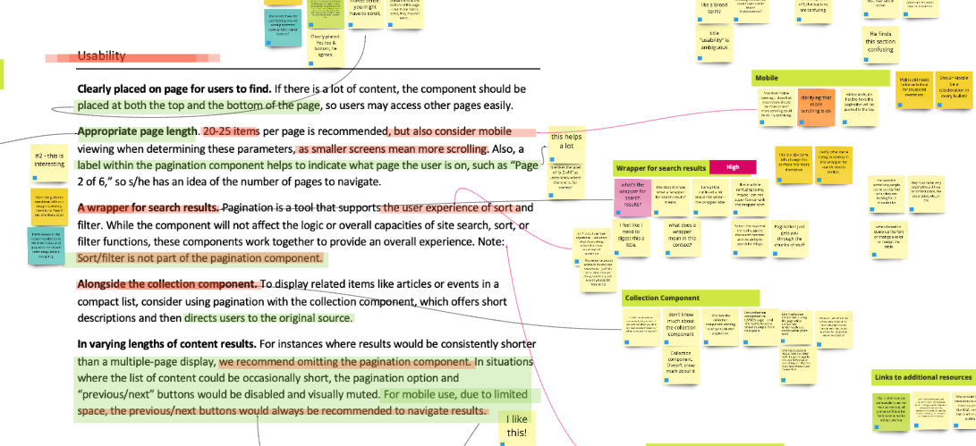
Usability testing analysis (guidance)
Notes:
Slide 18: Here is an example of how we analysed user feedback for the component guidance, which we also tested as a form of content research. The image on this slide depicts a section of our data analysis board, with the visual representation of the pagination guidance. As we were going through user feedback, we annotated the guidance according to what we heard: the areas of clarity are highlighted in the text in green, and the areas of confusion are noted in red. We also added user insights on the sticky notes alongside the guidance, grouped by themes.

Slide 19
Best practice: Direct observation
UX Designer and content editor being observers at the testing sessions, which streamlined iteration process.
Notes:
Slide 19: Including a UX designer and a content editor as observers at the testing sessions allowed our team to establish early learnings and alignment and also streamlined the iteration process.

Slide 20
“Pagination is another form of navigation. It’s kind of a context-specific navigation.” UX Designer
Notes:
Slide 20: One of the UX designers we spoke to in our usability testing told us this: [QUOTE] “Pagination is another form of navigation. It’s kind of a context-specific navigation.”

Slide 21
Iteration
What we did: Review and prioritize findings. Made confident changes to the component’s design and guidance
Outcome: Final design of pagination component and updates to guidance
Notes:
Slide 21: Iteration phase: We reviewed and discussed usability testing insights as a team and made design and guidance improvements. Here’s a look at the final visual design

Slide 22
Pagination design iterations
First prototype
Refinements after testing prototype
Notes:
Slide 22: On this slide, there are two iterations of USWDS pagination component. The top one is the first version that we tested with users. It features four gray page navigation buttons on the left side of the page, with the current page highlighted in the blue link color. Then, on the right side of the page, a grouping with previous and next buttons with only an icon, and a "View all results" link. Below is the version that we made based on our usability testing.
First, our revised version removes the horizontal gap between the page buttons and the previous/next buttons. While this was a clean solution, we found it was more effective to keep all the controls together. We also try to reduce horizontal gaps in the reading order because some users — particularly those with low vision or using screen magnifiers — find it hard for their eyes to follow horizontal gaps.
Next, we wanted to improve the core functionality of the pagination component — showing the current page and focusing on clear navigation actions. In our revision, we increased the number of page slots to seven, and made sure we always showed the first, last, previous, and next pages. We moved the Previous and Next buttons to before and after the pages, the position most users expect. We removed the "View all results" link to keep our component focused on essential features. We made the button borders less dark and the backgrounds transparent to reduce the weight on the buttons and keep the focus on the page numbers. We made the current page button the same as the text color (black) to make it seem less like an active link.
Lastly, though it is not shown here, we adjusted the mobile version, to make it more consistent with the desktop version.

Slide 23
Best practice: Cross-functional review
Cross-functional team reviewed validation phase findings and collectively made more-informed improvement decisions.
Notes:
Slide 23: By having a cross-functional team jointly review the findings of the validation phase, we were able to collectively make confident improvement decisions.

Slide 24
Demo
Notes:
And now I will hand it off to James, who will walk you through a technical demo of the Pagination component. Slide 24 continued. (James’s section) Thank you, Sofya. Hello everyone, my name is James Mejia. I’m a developer on the USWDS core team. So now, let’s see pagination in action. We’ve prepared a search results page, so we can demo the component in a more realistic example. If we scroll down to the bottom, we can see our new pagination component. Pagination has 7 slots available to display your pages. It’s best practice to always display the first page, the current page, and the last page when available. We’re using the default variant in this demo. This version is for more traditional datasets, where you get a fixed number of results. In this case, we have 12 pages of results. If we were to have 7 or fewer pages in our dataset, then we’d show all of the pages available within those 7 slots I mentioned. << resize screen >> On small screens, we simplify the component by only displaying the page numbers. No previous or next links are visible. This is why it’s important to show the first page, the current, and last page when available. Let’s take a closer look at a few states of pagination. << Switch to states demo >> This is the start of pagination on a small dataset. I previously mentioned showing all pages if the total number of pages are fewer than 7. << Show 2 of 3 >> If I work my way toward the middle of this small dataset, the first, current, and last pages are displayed and surrounded by the previous and next links. << Show 3 of 3 >> At the end of the small dataset, the next link disappears. Note: For accessibility, we add a special aria label for the last page. It reads “last page, page 3” in this case. Now, let’s take a look at what pagination would look like for larger collections of pages. For example, more than 7. << Show 1 of 12 >> At the start of larger collections, we show the first five pages, an overflow element —ellipsis in this case — the very last page, and the next link. << Show 6 of 12 >> In the middle of this larger dataset, we show the very first page, the overflow, the current page and its immediate siblings, another overflow element, and the very last page surrounded by the previous and next links. << Show 11 of 12 >> Toward the end of the dataset, we have the very first page, an overflow, and the last five pages, with previous and next links on either side. << Show infinite variant >> The other variant, infinite, isn't too different from our default. This variant is for unbounded datasets. It’s use case is smaller than the default. If you want to show a lot of search results ordered by relevance, this would be a good fit.
Its goal is to show as many pages as possible. At the start of the dataset, it looks similar to the default. However, instead of showing the very last page, like on the default, we show an overflow element to clearly indicate that there are more pages. << Show 2 unbounded >> As you progress through the pages, it’s visually similar to the default. << Show 6 unbounded >> Our last example shows us progressing through to page 12 of an unbounded set of pages. << Set current item to 12 >> Settings Pagination has 5 available component settings: $theme-pagination-background-color for accessible link color setting. We can see how this works by setting “ink” as a background color in our demo and updating the components background color variable to “ink”. << Uncomment code in template - Set variable to “ink” >> The rest of the settings for pagination are pretty straightforward. Besides $theme-pagination-background-color, we have: $theme-pagination-breakpoint to determine at which breakpoint we show the full component. $theme-pagination-button-border-radius the roundness of the buttons $theme-pagination-button-border-width the border width of the buttons $theme-pagination-font-family the font used in the component. I hope you’ve found this technical demo useful and look forward to hearing your experiences with pagination. Now, Katie Kline will walk us through the pagination guidance. Thank you.

Slide 25

Pagination usability (1 of 2)
Show the size of the paginated set.
Highlight the current page.
Include the first, previous, and next pages.
Indicate any missing pages.
Notes:
Slide 25. Thanks, James! My name is Katie Kline, and I am a content strategist working with the USWDS team. Now we’d like to walk you through the highlights of Pagination guidance. There are several guidelines associated with using this component:
Show the size of the paginated set. Users want to know the length of a section that has been paginated. This is most commonly accomplished by always showing the last page as the last item in the navigation. Users should also know if the set is unbounded and has no discrete length. For example, some large search results will not have a “last” page. The USWDS Pagination component will always show the last page of the set as a navigable link, or show an ellipsis at the end of the links if the set is unbounded.
Highlight the current page. It’s important for the user to know where they are, and what page they're on.
Include the first, previous, and next pages. Users should always be able to navigate to each of these pages from any page in the set.
Indicate any missing pages. Whenever there are pages missing between two elements, indicate the absence of these pages with an overflow indicator like a non-selectable ellipsis.

Slide 26
Pagination usability (2 of 2)
Use as few navigation items as possible.
Show navigation items in a single line.
Use generous touch targets.
Optimize the number of entries per page.
Notes:
Slide 26.
Use as few navigation items as possible. Focus on essential actions and avoid adding more items (like extra page buttons) to Pagination just to fill space.
Show navigation items in a single line. Pagination can be hard to understand — and individual items can be more difficult to select — when the items break over one line. Avoid using Pagination in any context where it would be more than one line long.
Use generous touch targets. Use touch targets that are big enough to select with any finger and have enough separation to avoid mistakes.
Optimize the number of entries per page. Consider page load, performance, and the user’s scrolling preferences when determining how many items are displayed on each page. Some paginated content benefits from user control over the number of elements to show on each page.

Slide 27
Pagination accessibility
Pagination should be a <nav> element with a unique descriptive label.
Voice the current page with aria-current.
Assure that every navigation element is voiced as a “page” and that the last element is voiced as the “last page.”
Use a link for the current page for robustness.
Avoid large horizontal gaps between navigation elements.
Notes:
Slide 27. That was a high-level look at the usability of Pagination, but we have also given careful consideration to the accessibility of the component. Here are some additional guidelines you should keep in mind as well.
Pagination should be a <nav> element with a unique descriptive label. Clearly identify Pagination as a distinct navigation section to screen readers.
Voice the current page with aria-current. Using aria-current on the current page's link ensures the current page's link item is voiced as the current page for screen readers.
Assure that every navigation element is voiced as a “page” and that the last element is voiced as the “last page.” Provide as much context as possible to screen readers.
Use a link for the current page for robustness. While it may sound counterintuitive to link to the current page in your Pagination component, it makes sense to include this as a link, so screen readers voice the current page whether the user navigates by element or by tabbing.
Avoid large horizontal gaps between navigation elements. Users with limited vision or using a screen magnifier may stop scanning and miss an element if there's too much horizontal space between one element and the previous element in the reading order.

Slide 28
When to use Pagination
Search results. Pagination is most commonly used with paginated search results.
Multi-page collections of related items. Common examples include articles related to a category or tag, content archives, and history or activity.
Notes:
Slide 28. So when should you use the Pagination component? There are a couple of common use cases for pagination. Search results. Pagination is most commonly used with paginated search results. Multi-page collections of related items. Common examples include articles related to a category or tag, content archives, and history or activity.

Slide 29

When to consider something else
Meaningful page groupings. Meaningful page groupings are more like sections or chapters. Use conventional navigation.
Steps in a sequence. Use the step indicator component.
Short collections. Show all the items at once instead of paginating.
Notes:
Slide 29. And when should you consider something else? There are also cases in which Pagination is not the best approach. Meaningful page groupings. Meaningful page groupings are more like sections or chapters. Use conventional navigation like side navigation. Steps in a sequence. If you need to indicate progress through a series of steps that must be completed in succession, like a multipart form, consider using the step indicator component, use the Step Indicator component. And finally, Short collections. If the length of the entire collection is less than 3-4 screen lengths long, consider showing all the items at once instead of paginating.

Slide 30
Try out Pagination for yourself
designsystem.digital.gov/components/pagination
Notes:
Slide 30. This has been an overview of the usability, accessibility, and use cases of pagination — the full guidance for this component is available on our website at designsystem.digital.gov/components/pagination. Try it out for yourself and let us know what you find. Now, I will pass the mic back to Dan to discuss other product updates.

Slide 31
USWDS 2.12
Notes:
Slide 31. Thanks Katie — and thanks James and Sofya for giving us a quick introduction to Pagination. Pagination is a big part of USWDS 2.12, the latest version of the design system, released yesterday.

Slide 32
USWDS 2.12 Features
Pagination component
Spanish authentication and 404 page variants
More negative margin tokens
Body exdent in Card now works as expected
Checkbox and radio automatic accessible color options
State color tokens available in default utilities
Success-dark color token now looks better
Cleaner margins in radio tiles
Sketch and Adobe XD design assets for Pagination
Notes:
Slide 32. In addition to Pagination, there are a number of useful new features and bugfixes in USWDS 2.12.
We now have Spanish-language versions of the 404 page and the authentication templates.
Margin tokens now go down to negative four and negative five.
The Card body exdent modifier now works as documented.
Checkboxes and radio buttons — and their tile variants — now can better respond to custom background colors. The system will build checkboxes and radio buttons wil accessible color contrast, no matter what background they’re on.
The default utilities now include state color tokens in addition to the theme color tokens.
We updated the default of the success-dark token to be more vibrant and look more like the regular success token.
We cleaned up the spacing and margin around radio tiles.
And we also released the Sketch and Adobe XD assets for Pagination!
And that’s USWDS 2.12!

Slide 33
USWDS 1.6.14 Security Update
Notes:
Slide 33. For those of you that might still have projects on the USWDS 1.x branch, we also released a routine security update to that branch this week: USWDS 1.6.14. So if you maintain USWDS 1.x projects and you’d like a version with newer dependencies, try 1.6.14.

Slide 34
External links guidance update
designsystem.digital.gov/components/link
Notes:
Slide 34. External link updates
In March, we updated our link guidance. Since then, we've been receiving feedback about how to make it better. Today we're revising this guidance to respond to this feedback.
For links, the key takeaway we want to make as clear as possible is that we must both clearly identify external links and provide required notification for non-federal external links. Specifically, we must address two aspects — notification and non-endorsement:
Notification: We recommend employing a clear, consistent, user-friendly approach for all external links whether government or non-government links. Include the destination for all links that send users from your site to another site (see What you should do, below).
Non-endorsement: We recommend adding language to a policy and notices page on your site to explain to users that the agency does not endorse the information on any linked non-federal site. See, for example, USA.gov’s linking policy.
We've made updates, improvements, and clarifications throughout our link guidance. We’re still conducting research on how and when to use indicators (like icons) on external links plus the best way to communicate to users that a link will take them away from your site. We’ve marked these areas as “under review,” and we’ll keep you posted on what we learn in the coming months. Head over to our link guidance page at designsystem.digital.gov/components/link and let us know how we're doing.

Slide 35
Library beta
Our next development focus
Notes:
Slide 35. And finally, through the many twists and turns of the last few months, we’ve also continued to make progress on the updates to our project structure and internal component library. We’ll have a new version of this work to try out as a beta next week. It doesn’t have any additional user-facing functionality, but that’s part of the point — we’re trying to make a number of changes under the hood that you won’t notice at all. Completing this work is our next development focus — and at the next call, we’ll be talking more about what this means for the design system moving forward, as we begin to think about USWDS 3.0. But that’s a topic for another day! Now, on to slide 36 and answering your questions!

Slide 36
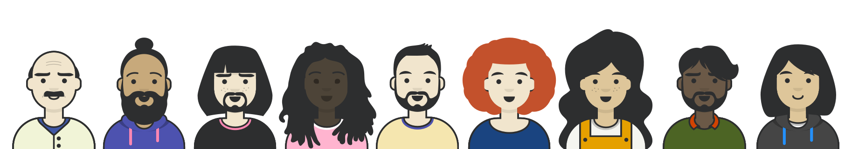
Q&A
Notes:
Slide 36: We’re going to stop the recording and answer some questions!

Slide 37



Next month
July: We’re taking a break!
August: Where do we go from 2.0?
#uswds-public
github.com/uswds
designsystem.digital.gov
Notes:
Slide 37. Thanks for joining today's USWDS monthly call. Next month, we are taking a break and having a July monthly call vacation. I don’t know about you, but we could really use it. We’ll be back in August to talk more about some product roadmap element updates, and what we’re thinking as we begin to look beyond the current version of the design system. And, as always, I encourage you to join our community in the #uswds-public Slack channel so you can follow our progress, get answers, and contribute to the discussion. Follow us on Github at github.com/uswds, check out our website, and visit designsystem.digital.gov/about/community to join us and your colleagues across government who are using USWDS. Thank you, and see you in August!

